Slide 1
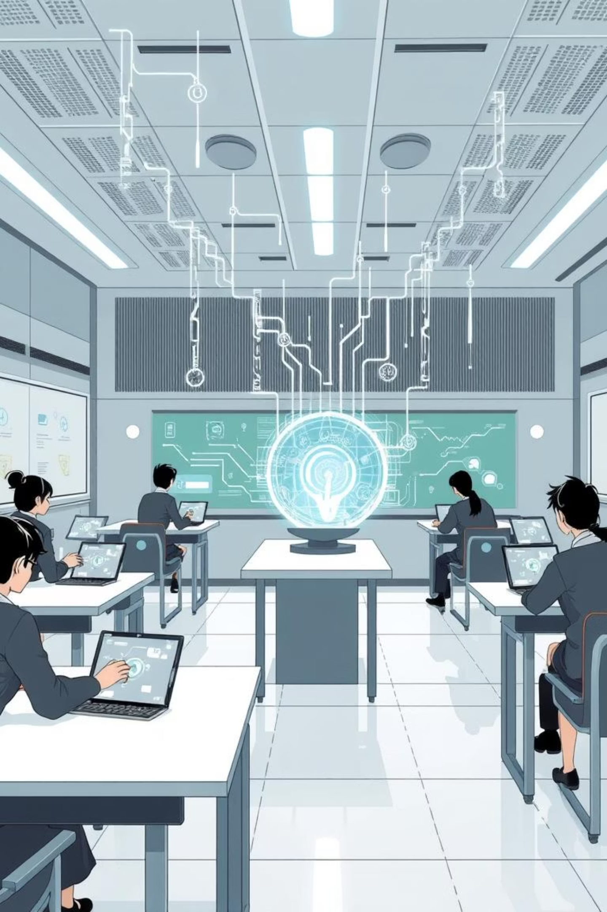
Adaptive Learning System
Presented by: Aira, Unaiza, Fatima Khalid, Somal
Professor: Attiqa

Slide 2
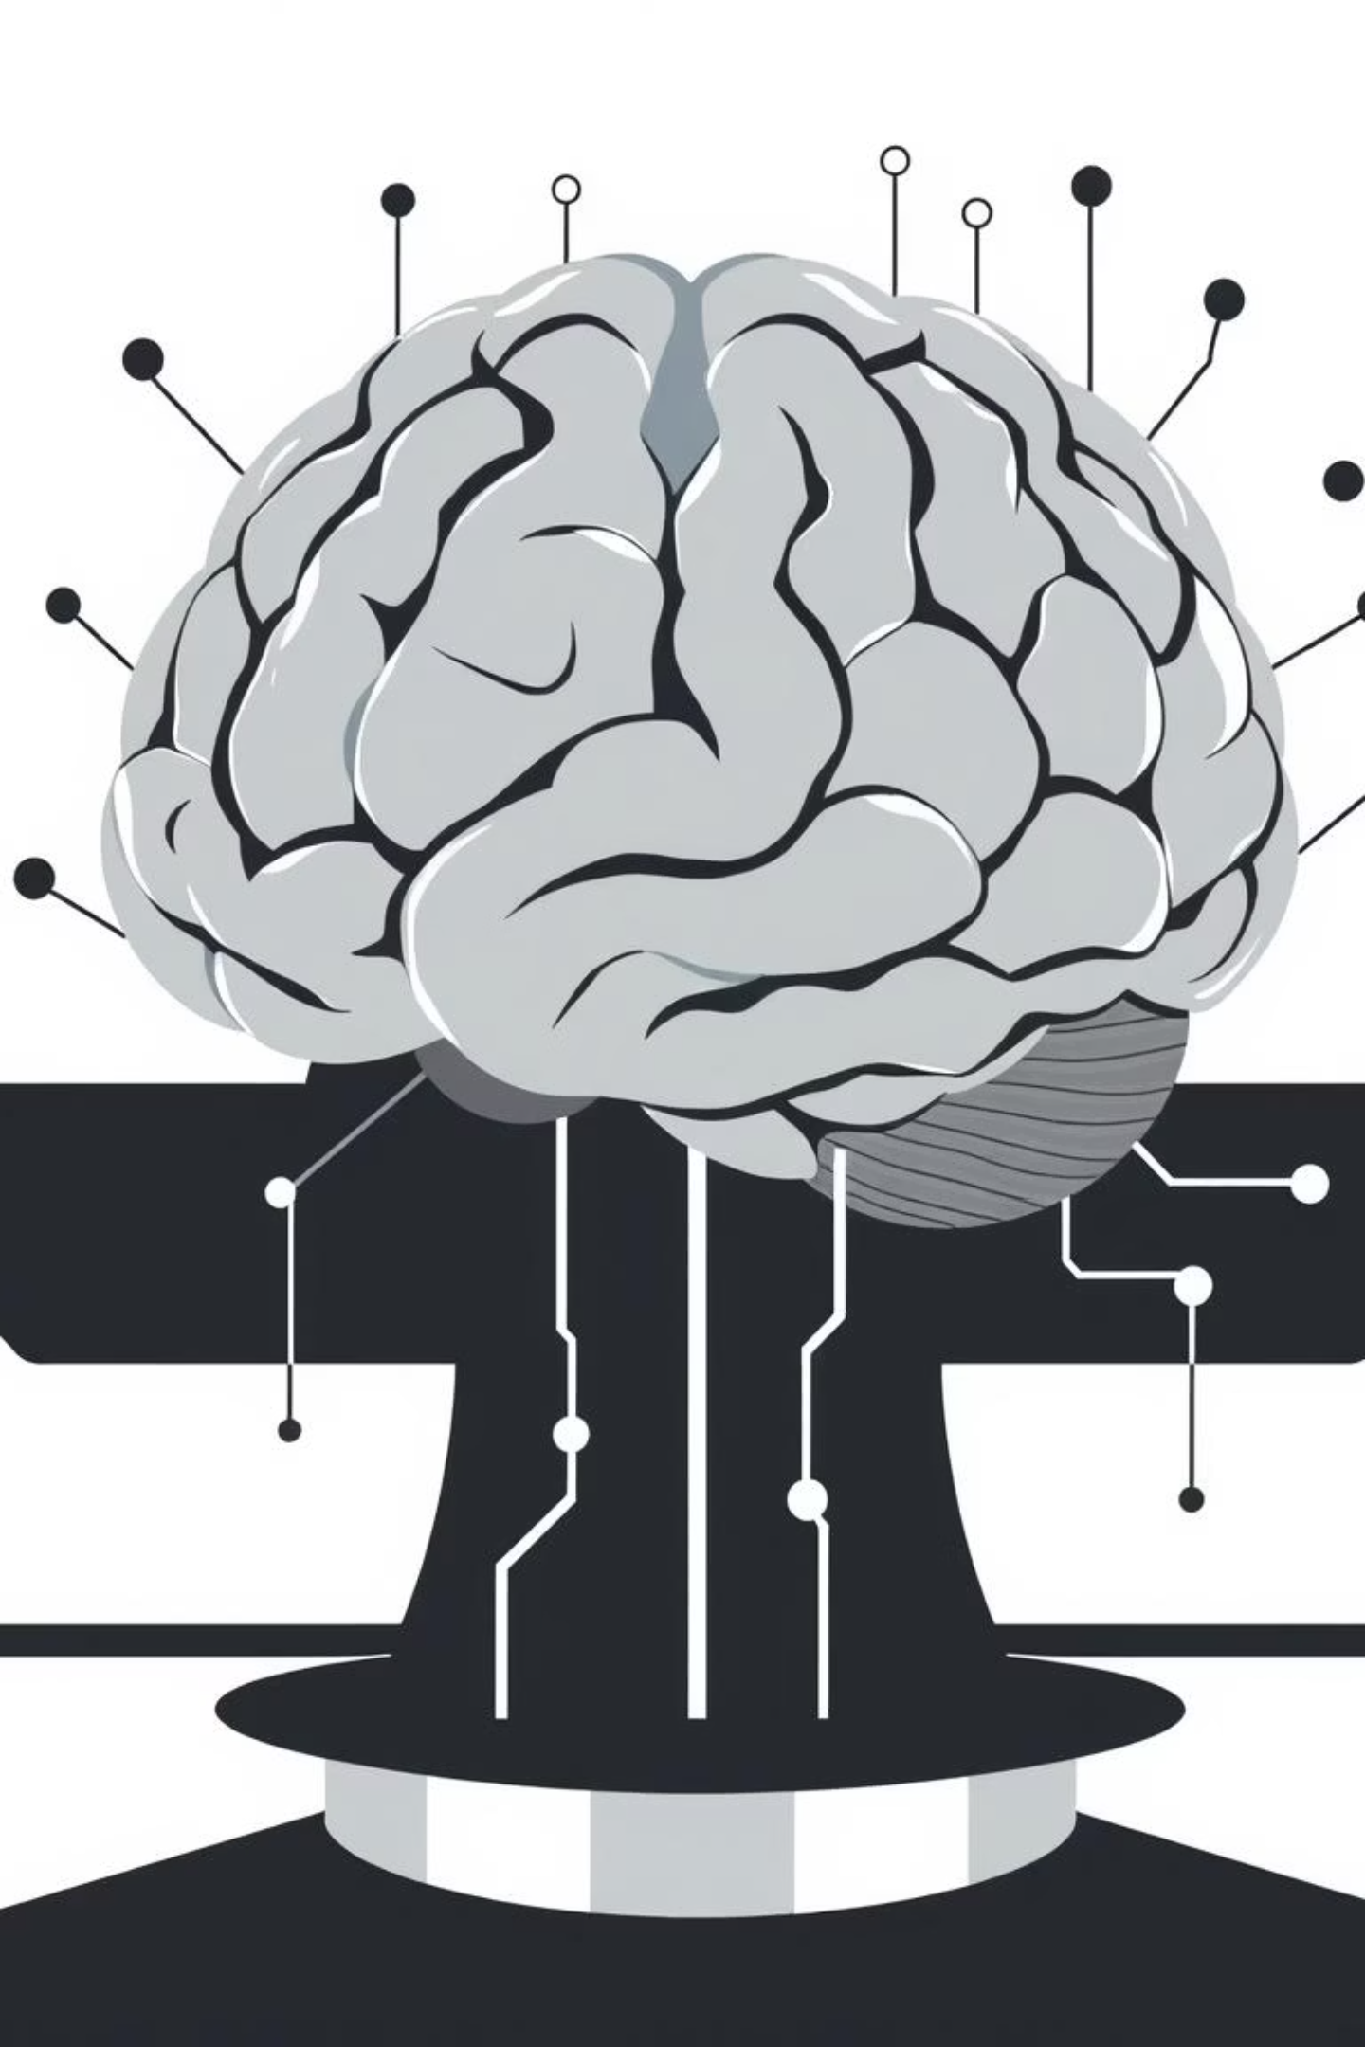
Introduction: AI-Powered Education
This project introduces an AI-based student performance analytics system. It analyzes learning behavior and recommends personalized learning paths, assisting both students and teachers in academic decision-making through interactive dashboards and AI-driven logic.

Slide 3

Core Objectives
Analyze Performance
Visualize Metrics
Recommend Paths
Utilize AI techniques to evaluate student performance.
Display academic data through intuitive dashboards.
Suggest personalized learning paths using AI logic.
Teacher Insights
Real-World AI
Provide performance insights for educators.
Demonstrate practical AI application in education.

Slide 4
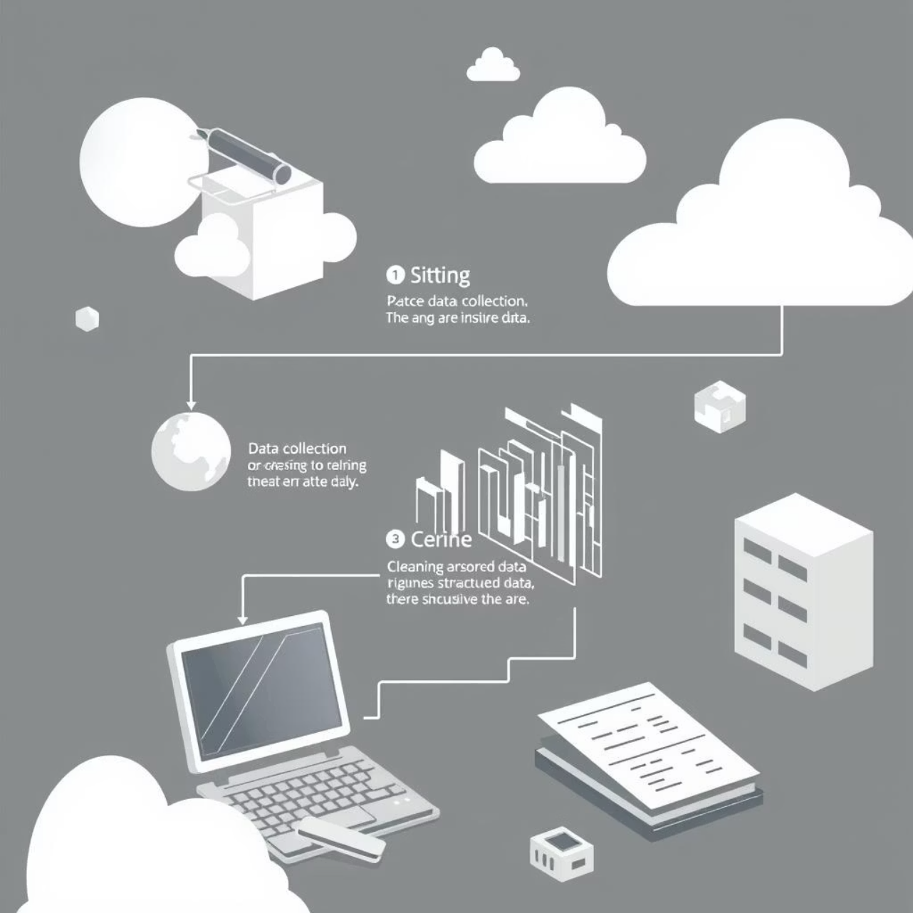
Module 1: Data Collection & Preprocessing
This module collects student data like quiz scores, study time, and engagement levels. It then preprocesses this data to ensure quality for accurate AI analysis.
Handling missing or inconsistent values
Normalizing numerical data
Preparing clean, structured input for the AI model

Slide 5
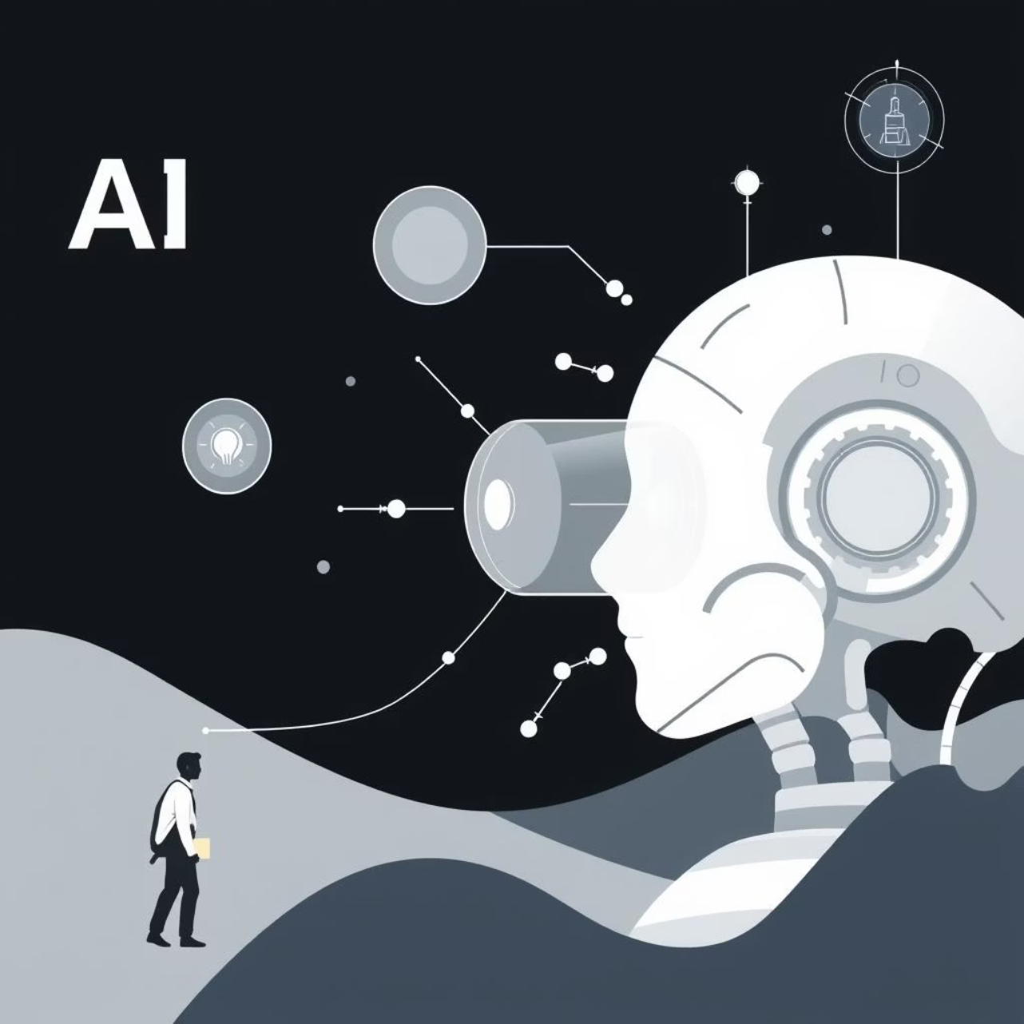
Module 2: AI Model Development
An AI model is developed to analyze student performance, evaluating input features and identifying learning patterns. Based on performance thresholds, it categorizes students into learning levels:
Beginner
Intermediate
Advanced

Slide 6




Module 3: Adaptive Recommendation System
This module uses the AI model's output to generate personalized learning recommendations, dynamically adapting as new student data is provided.
Learning Paths
Study Intensity
Skill Focus
Suggests appropriate learning paths.
Adjusts study intensity.
Highlights areas for skill improvement.

Slide 7
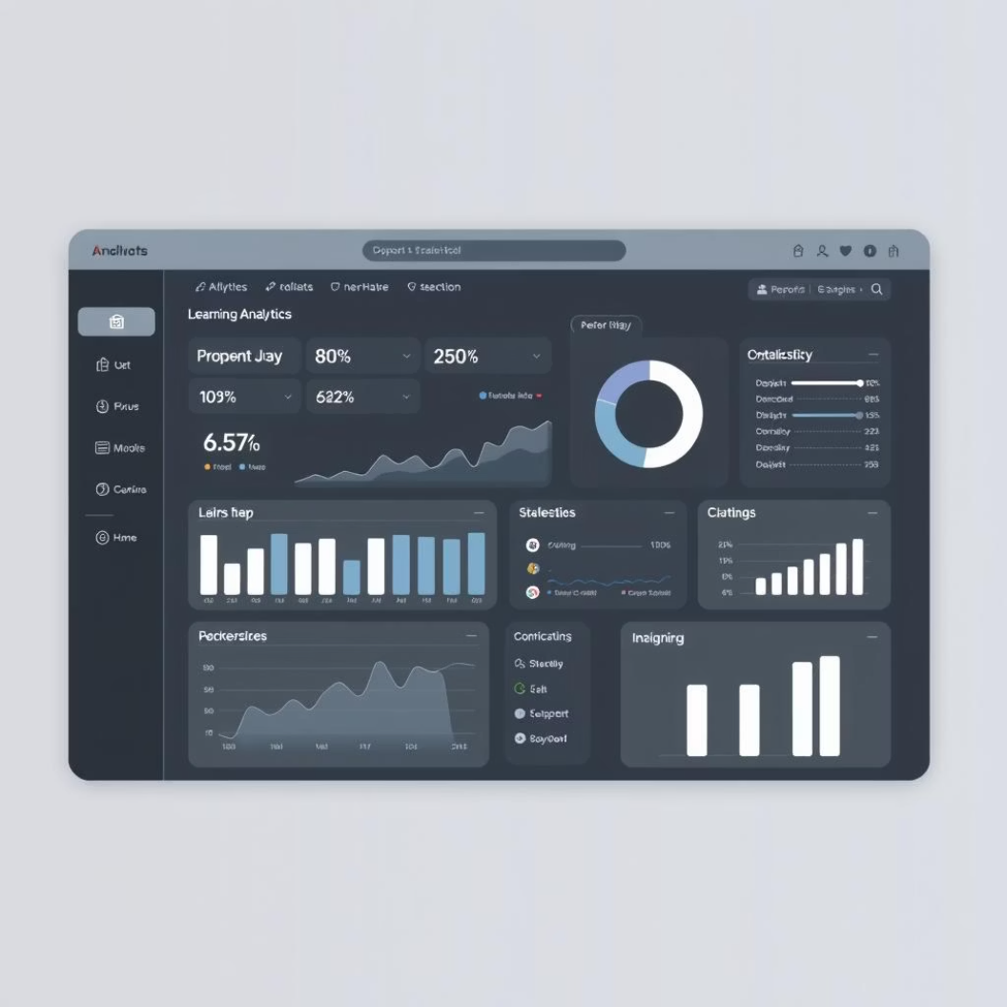
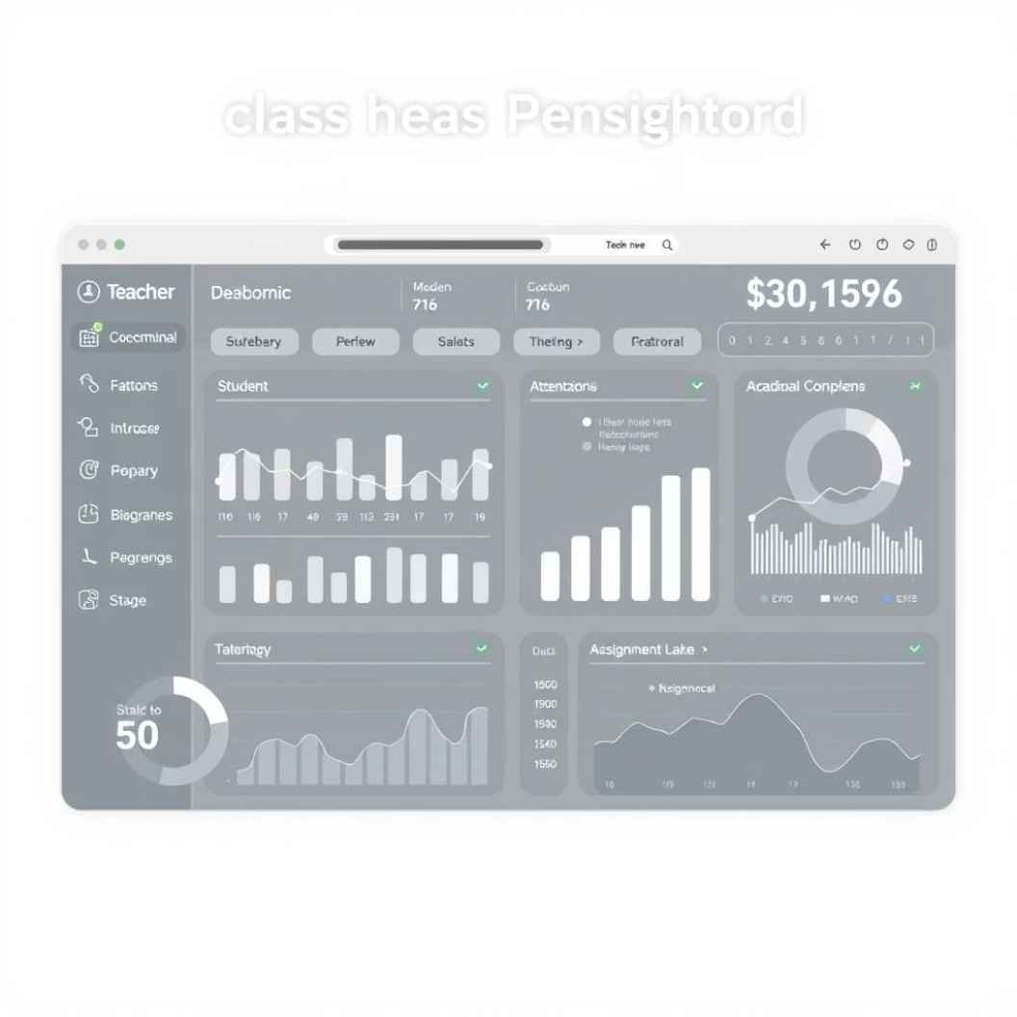

Module 4: User Interface & Integration
This module focuses on the system's design and integration, providing intuitive interfaces for all users.
Student Portal
Teacher Insights
Interactive Visualizations
For performance input and analysis.
Dashboard for class-level analytics.
Nested charts and predictor maps.

Slide 8
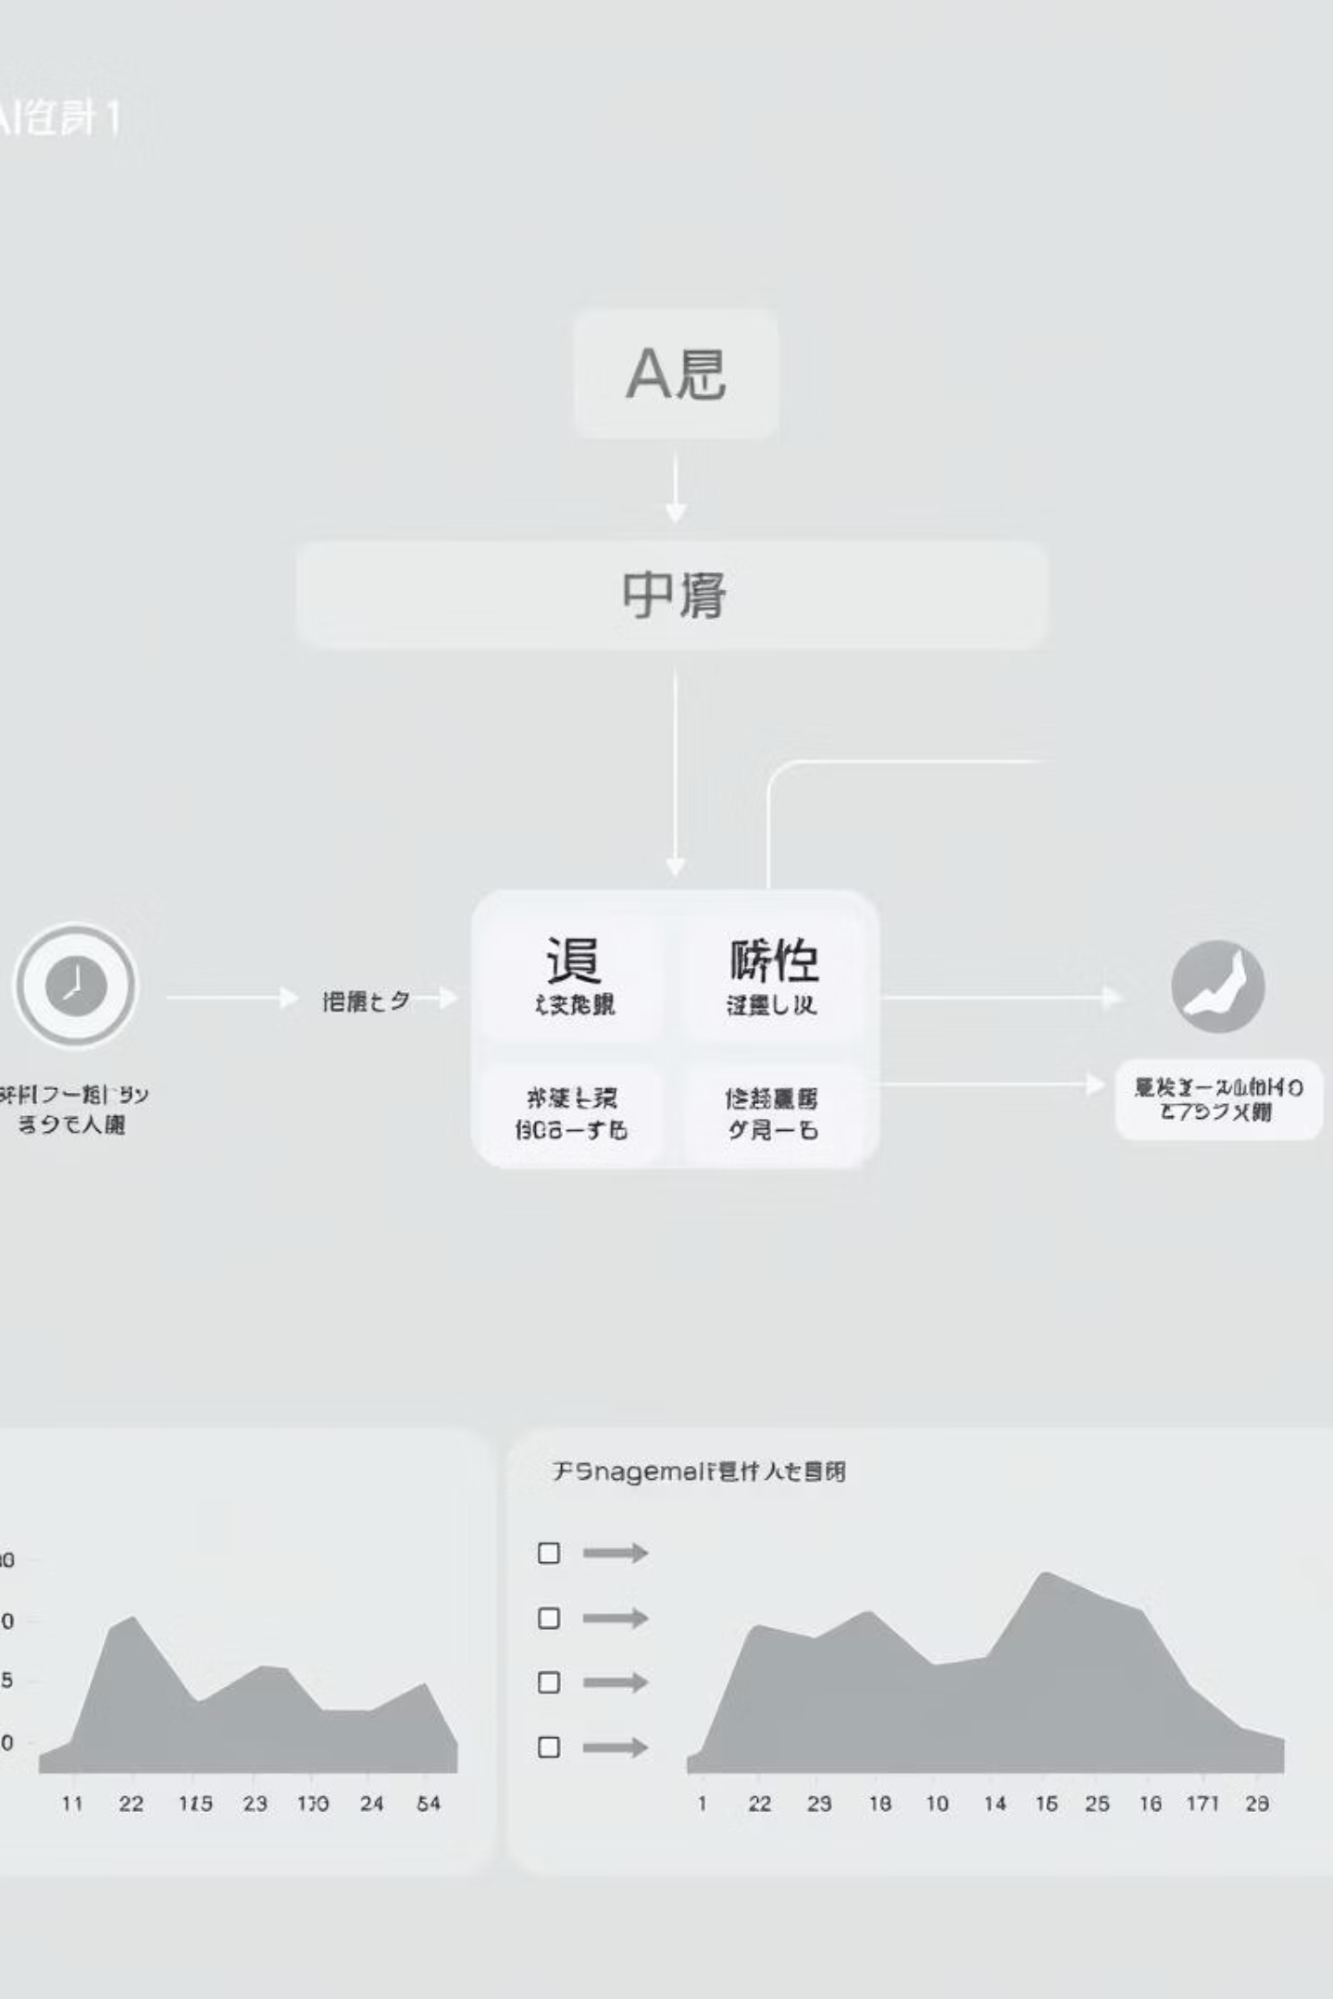
Key Features & AI Implementation
Performance Input Controls
Interactive Data Visualization
Quiz Score (%) slider
Nested Circle Charts for individual performance
Study Time (Minutes) slider
Engagement Level indicator
Scatter Plot Predictor Map for class-level analysis
AI Recommendation Engine
AI Logic
Recommends learning paths (Beginner, Intermediate, Advanced) based on performance and engagement.
Categorizes students using performance thresholds and engagement analysis.

Slide 9
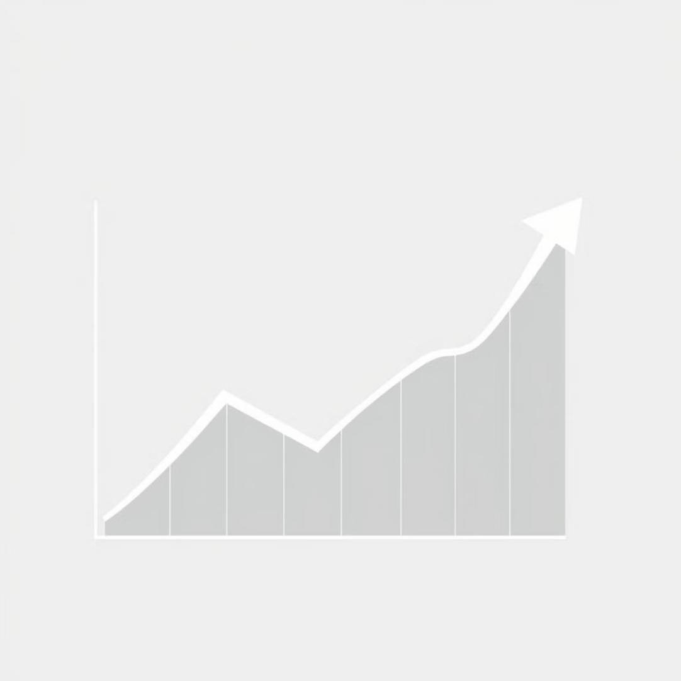

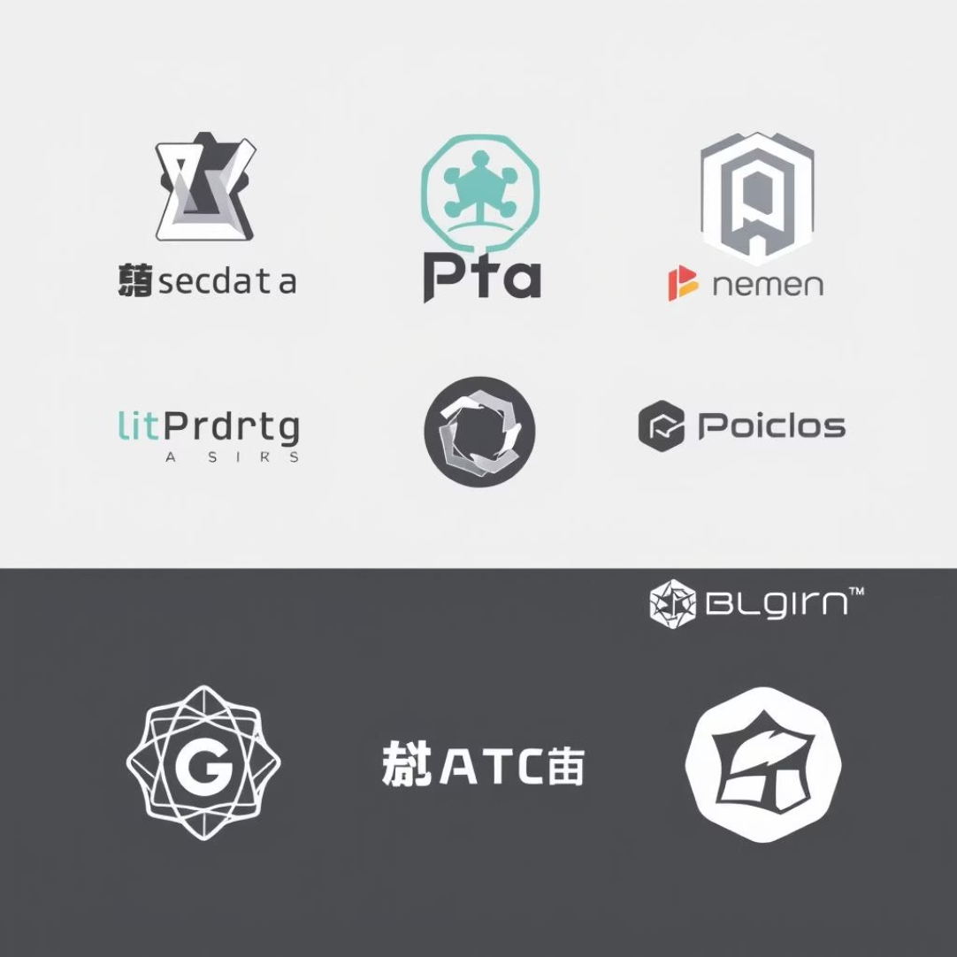
Tools, Results & Conclusion
Tools & Technologies
Results
Conclusion
Python
The system provides real-time analytics, AI-based recommendations, and visual insights, supporting improved learning outcomes.
This project effectively applies AI in education by integrating analytics, visualization, and intelligent recommendations for enhanced learning.
Gradio Framework
NumPy, Pandas
Matplotlib / Plotly

Slide 10

Future Enhancements
ML Model Integration
Cloud Deployment
Database Integration
Authentication & Access

Slide 11
Thank you

